Slide 1
An Intro to Lambda Architecture
Josh Lane
@jplane

Slide 2

Josh Lane
Independent consultant
20+ years as developer, architect, instructor, amateur psychiatrist
Finance, insurance, education, telecom, energy
Microsoft Azure MVP
@jplane
Twitter, GitHub, LinkedIn, GMail

Slide 3

Data Challenges in Enterprise
Throughput
Scale
Heterogenous schemas
Versioning
Single Source of Truth™
Authentication
Storage technology

Slide 4

Data “liveness” vs. data scope
Latency of insight vs. depth/breadth of insight
Batch vs. stream

Slide 5
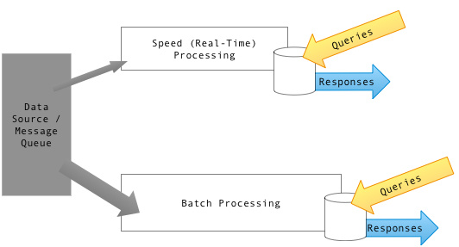
Lambda Architecture

Slide 6









Slide 7
Guitar solo

Slide 8
Lambda Architecture

Slide 9
Lambda Architecture – Azure
Queries
Responses
Queries
Responses

Slide 10
Lambda Architecture – Azure
Message ingest
IoT Hub
Speed processing
Stream Analytics + Cosmos DB
Batch processing
Data Lake
Serving layer
Power BI
Cheap long-term storage
Blob Storage
Event-driven processing
Event Grid

Slide 11
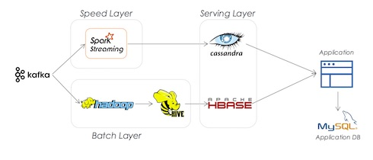

Slide 12
More info
https://en.wikipedia.org/wiki/Lambda_architecture
https://azure.microsoft.com/en-us/services/iot-hub/
https://azure.microsoft.com/en-us/services/stream-analytics/
https://azure.microsoft.com/en-us/solutions/data-lake/
https://azure.microsoft.com/en-us/services/cosmos-db/
https://powerbi.microsoft.com/en-us/
https://azure.microsoft.com/en-us/services/event-grid/

Slide 13
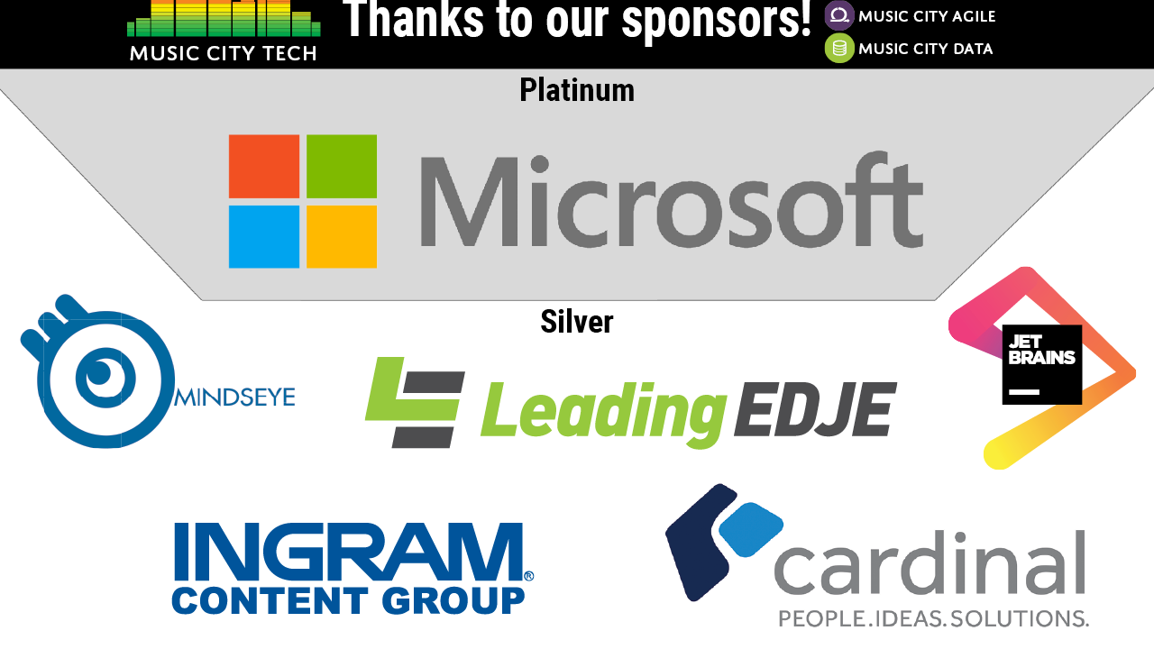

Slide 14
Thank you!

